Slide 1

TECHNOLOGY & THEORY
CONVENIENT CAR PARKING SYSTEM
An In-depth Guide on how our car
parking System would help in bringing a change

Slide 2

CONTENTS
A brief outline
SECTION 1: THE PROBLEMS
What are the some current problems?
Where is the system lacking?
Is it worth the fix?
How important it?
SECTION 2: THE ACTION
Planning the Course of Action
Prototyping
Bug Testing
SECTION 3: THE FUTURE
Looking for upgrade and collaborations
Additional improvements
Expanding beyond parking spaces

Slide 3




WHAT IS THE PROBLEM?
PROBLEM 1
The biggest problem in parking spaces is that so we do not have any idea where we are getting our car into, we will find space or not.
PROBLEM 2
Paid Parking areas, people pay for parking their car in lots where is no security of their vehicles, and no one can be held accountable.
PROBLEM 3
Non-efficient, old school methods to collect payment from people and give them receipts, no modern approach to this problem.

Slide 4

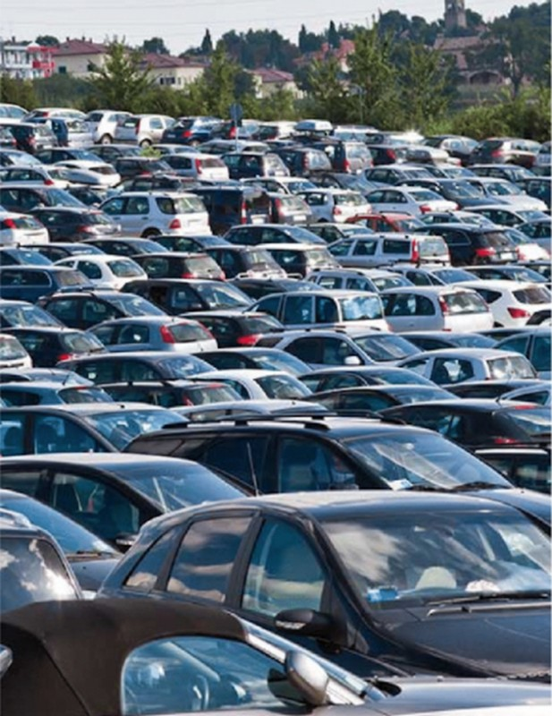
HOW ARE WE SOLVING THE PROBLEM?

Slide 5


HOW ARE WE
MAKING A CHANGE?
Using Python as our main coding language, and using powerful and efficient l ibraries, we have created a
program, that will eliminate this hassle.
Using this program, and integrating them with the
current electric toll gates, we can identify and manage the number of cars entering and leaving the parking
space.
Our Program is so advanced, that we need zero human effort, everything is done by the code itself, it
automatically recognizes the car number, takes input and creates an entry.
With our code, we add an extra- layer of security, which will help car owners always be informed about their car status, whenever they wish to.

Slide 6
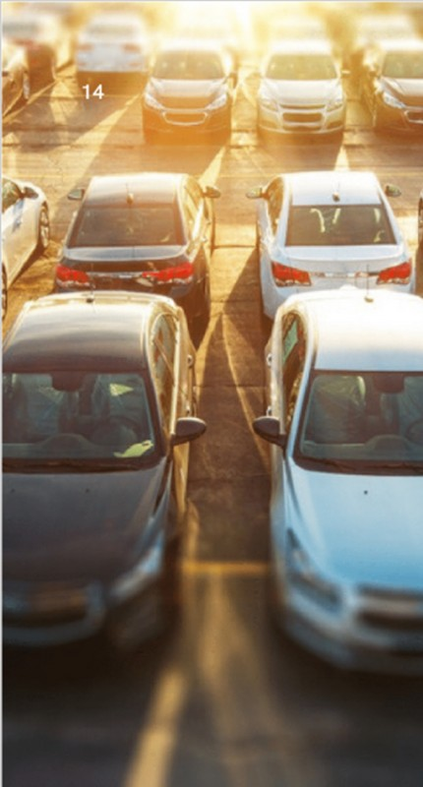

OUR MAIN AIM
"To minimize the hassle car
owners have to face on a regular basis.”
Using our modern and futuristic method, we can solve problems like finding a good place to park, having peace of mind with our security measures, and always being informed about your vehicle.

Slide 7

BUT WHAT IS THE FUTURE OF THIS APPLICATION?

Slide 8

EXPANDING THIS PROGRAM
Our whole aim with the program is just expansion, it is one of the most important part of our idea, and yes we believe in it.
By pitching this idea to established payment processors, and using their resources combined with our ideas, we can expand our idea to the whole country and the whole world.

Slide 9
THE
EXPANDABILITY

Slide 10

THE AREAS
As the equipment is so portable and user-
friendly, we can expand to smaller
parking spaces.
THE VEHICLES
With Cars as our main focus, we will soon add features for motor-bikes, bus, trucks, etc.
LIVE STATUS
By adding a screen which displays real time status to the user for the parking spaces.
CASHLESS PAYMENT
Linking payments with Fastag, so that you
don’ t have to manually pay for a visit to the
parking space.
RESERVATION
A system where user can book a parking space prior to his visit to save more time.
DAILY PASS
In Office spaces, the daily users would get a pass, so that they save both their time and money.

Slide 11
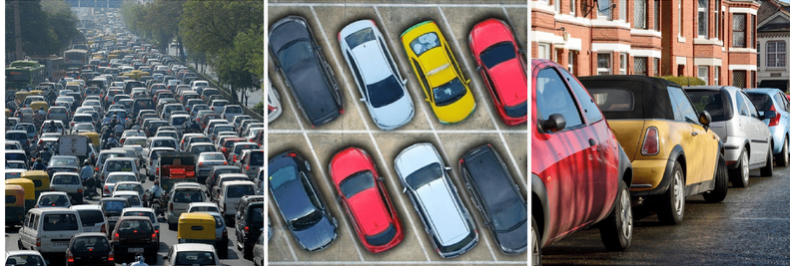

Slide 12

THIS WILL BE THE SOLUTION
TO THE FUTURE
Yes, we will move forward with this
startup beyond whenever the needs for this project would be fulfilled, we
believe in this idea, and we are
confident that this will bring a change

Slide 13
Be Inspired
IMAGINATION IS MORE IMPORTANT THAN KNOWLEDGE.
ALBERT EINSTEIN

Slide 14
THANK YOU!
- BHAVYA
Git Hub: https:// github. com/ bhavyassehgal Linked In: https:// www. l inkedin. com/ in/ bhavyassehgal/
Gmail: bhavyasehgal 512 @ gmail. com

